Slide 1

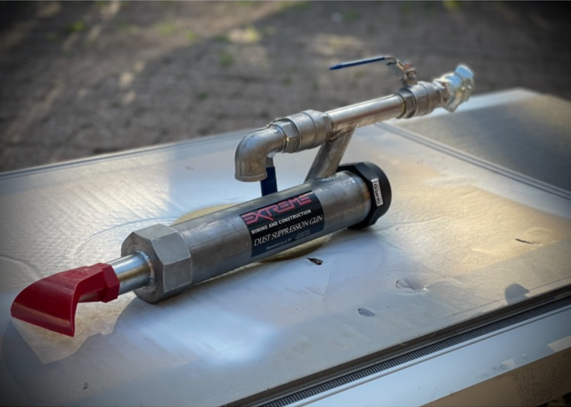
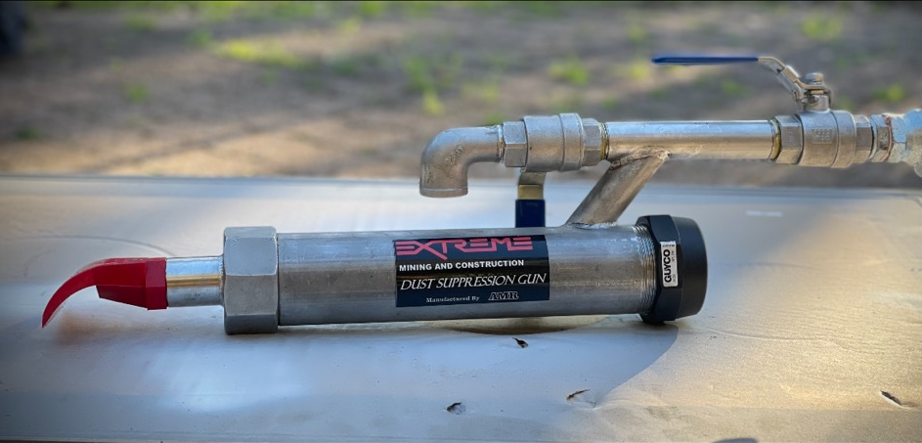
Introduction
The Extreme dust gun is used in conjunction with the Kapture QD dust suppression candles to wet down dusty work sites in remote areas or remote roadways you cannot gain access to with conventional water carts or suppression systems.
How it works -
Simply insert a quick dissolve candle into the barrel of the dust gun , connect your water supply and turn on
Usages
Used in dusty belt roads when recovering or installing structure
Wetting down dusting seal sites prior to building seals
Wetting down work areas in longwall tailgates around cans and link n locks
Suppressing problem roadway dust where you can’t access with conventional water cart methods
For more information contact Extreme Mining and Construction:
Troy Davies 0474 055 223 troy@exmc.com.au

