Slide 1


Drill Bit New and Refurb Proposal

Slide 2

BUSINESS CAPABILITY STATEMENT
Introduction
Extreme Mining and Construction is a small Australian family-owned business specialising in products and advise for the Mining and Construction industries.
The company has been supplying recycled drill bits to the mining industry for almost 2 years now with a phenomenal reputation for quality and service backed up by over 25 years of mining experience and expertise.
Our strategy is to utilise relationships built within the mining and construction industries to offer quality products old and used with a keen goal on recycling.
Our mission is to identify practical and efficient solutions for our clients aimed to increase productivity in all sectors and offer cost saving products without compromising on quality.
We are committed to providing high quality products and adding value to your projects through smart innovative engineering and advise.
What sets Extreme Mining and Construction apart from the competition?
At Extreme we offer a gold standard of service to offer our clients personal customised solutions backed up by years of experience in the mining and construction industries. We are small and 100% Australian owned with a main objective of increasing productivity and saving costs while doing our bit for the environment.

Slide 3
Refurb Assessment Process
Site visit to assess equipment strata and consumables currently in use.
Discuss holes per bit to work out efficiency and refurb requirements
Discuss with site representative on the refurbishing process.
Setup recycling system with site representative and underground crews
Setup recycling system with stores and dispatch.

Slide 4
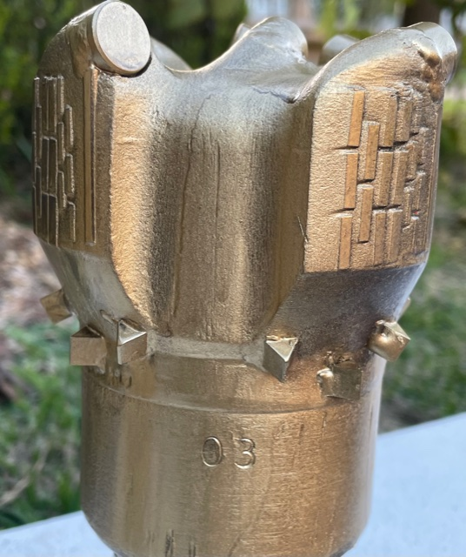
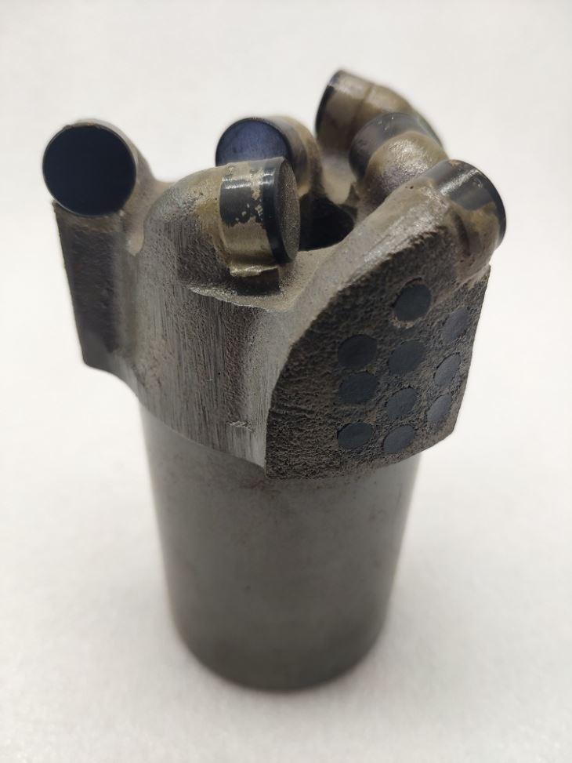
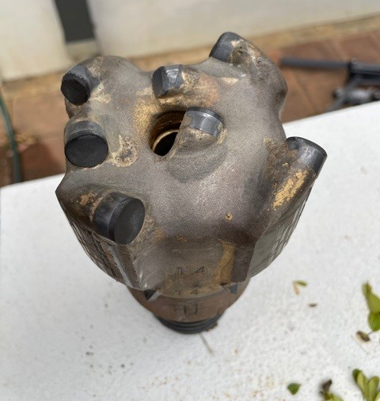
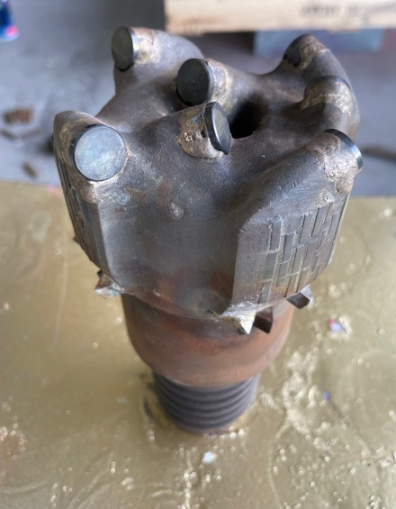
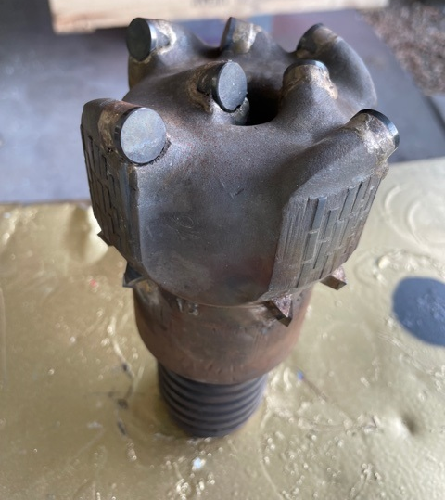
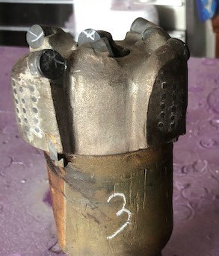
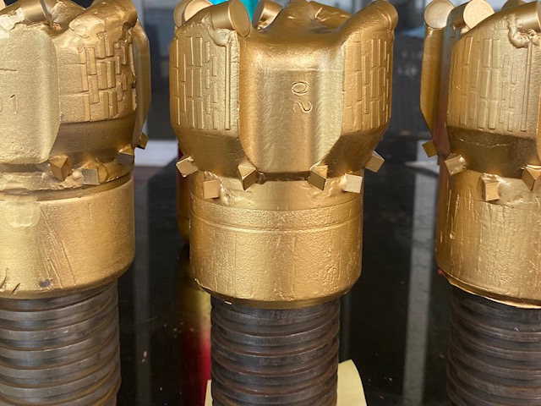
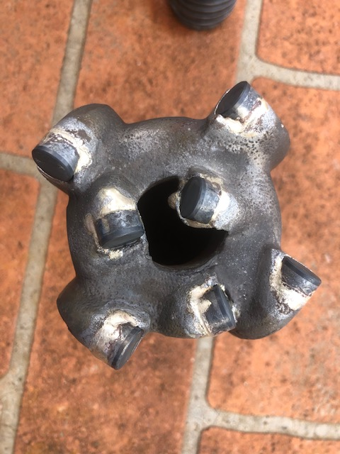
PCD Refurb Process
Clean and assess
Clean and assess bits to establish refurb requirements and quantities
Quote
Quote quantity needed to refurb
Remove
Remove damaged cutters
Rotate
Rotate worn or damaged cutters to the non cutting side of the bit
Weld
Weld new cutters and rotatable cutters on
Grind
Grind identification mark on bit to keep track of number of times refurbed
Check and QA
Check and QA refurbished bits
Spray
Spray bits and deliver to site

Slide 5

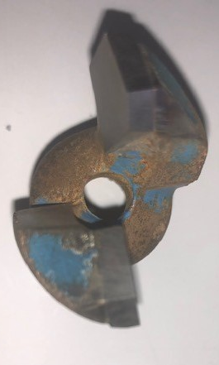
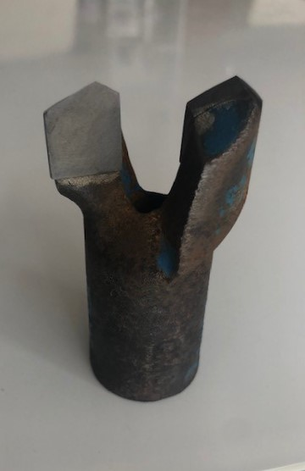
Carbide Refurb Process
Clean and assess
Clean and assess bits to establish refurb requirements and quantities
Quote
Quote quantity needed to refurb
Sharpen
Sharpen worn cutters
Grind
Grind identification mark on bit to keep track of number of times refurbed
Check and QA
Check and QA refurbished bits
Spray
Spray bits and deliver to site

Slide 6


Costs and benefits to refurbed bits
Less Waste
Large cost saving
Less stock to be held in store
Reduction of environmental impact

Slide 7
Drill Bit Refurbishment vs Buying New Trial
A four-week trial of using refurbed drill tips has been undertaken with the refurbed tips being utilized from local secondary support team on longwall.
Performance of the refurbed tips has matched that of the new tips in use.
Financials
A financial analysis of the Longwall 25 gate road and installation roads has been performed. The table below shows the workings.
3 refurbs per new drill bit
3 holes per bit – this may vary but limiting tips to two holes allows more Refurbs per tip as body and tip wear if reduced.
New tip cost assumed at $110 per tip
New Bit Cost | $110.00
Refurb Cost | $40.00
Holes per Bit | 3
Refurbs per Bit | 3
MG 25
8m Megas
Per Pillar | 200
Pillars | 30
 | 6000
New Bits | $220,000.00
Refurb | $60,000.00
Replacement Bits | $55,000.00
Savings | $105,000.00

Slide 8
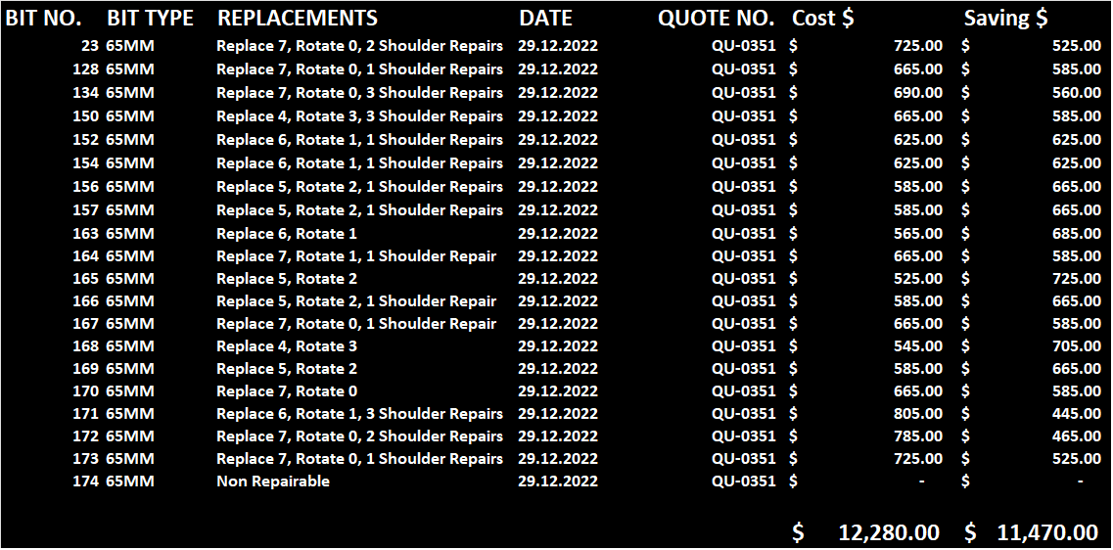
Savings and quality check example 65mm
(1 Month Period)

Slide 9
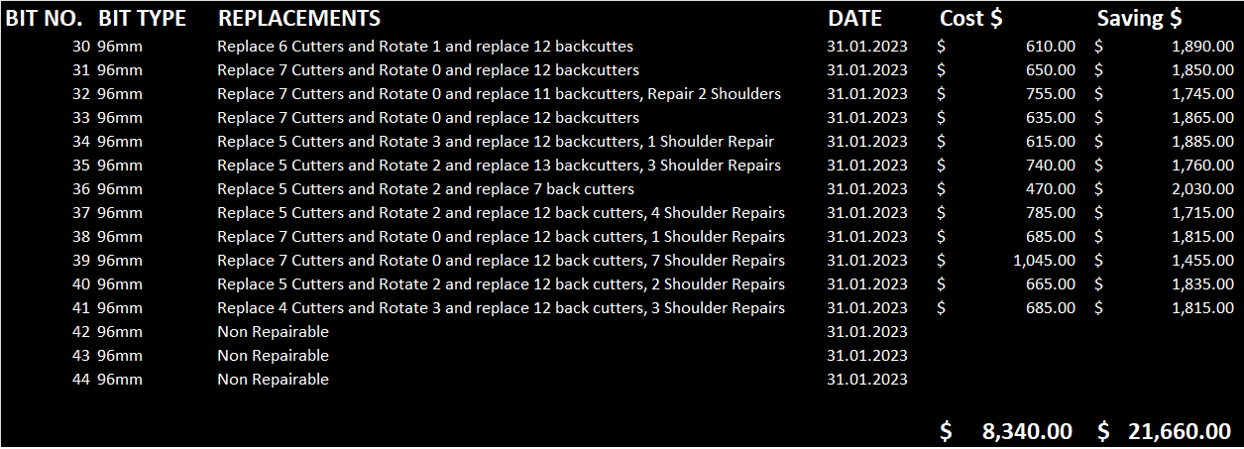
Savings and quality check example 96mm
(1 Month Period)

Slide 10
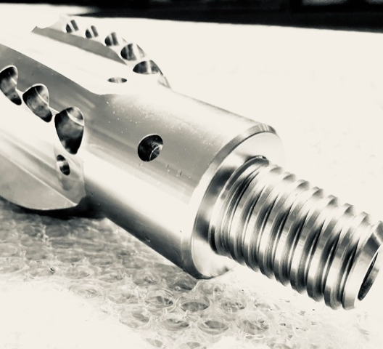
New products can supply
Reamers – Various Sizes
PCD Drill Bits – Various Sizes
Carbide Drill Bits – Various Sizes
Drill Dollies and Extensions

Slide 11
Testimonial
9 June 2020
To whom it may concern
Testimonial – Extreme Drilling Tools
We have been dealing with Extreme Diamond Tools for the past 6 months and we have found Troy and his team excellent to deal with. The turnaround from when he picks the bits up to refurbing and dropping them back is quicker than purchasing a new bit from our supplier. We have saved thousands along the way. The price of a new bit vs refurb from extreme tools is second to none. Performance wise – we have had no issues with Extremes Bits lasting after the first refurb, in fact they sometimes last longer than a brand-new bit I would highly recommend Troy and his team at extreme to anyone in the mining industry Yours sincerely
Mitch Fagan
NSW Drilling Manager VLI
T. +61 2 4964 2309 M: +61 427 479 520 E: mfagan@vli.com.au

Slide 12
Contact Us
Sales and Service – Troy Davies – 0474 055 223 – troy@exmc.com.au
Admin and Accounts – Trasi Davies – 0422 502 866 – admin@exmc.com.au
Website – https://exmc.com.au/
83 Jonathan Street, ELEEBANA NSW 2282

